Slide 2
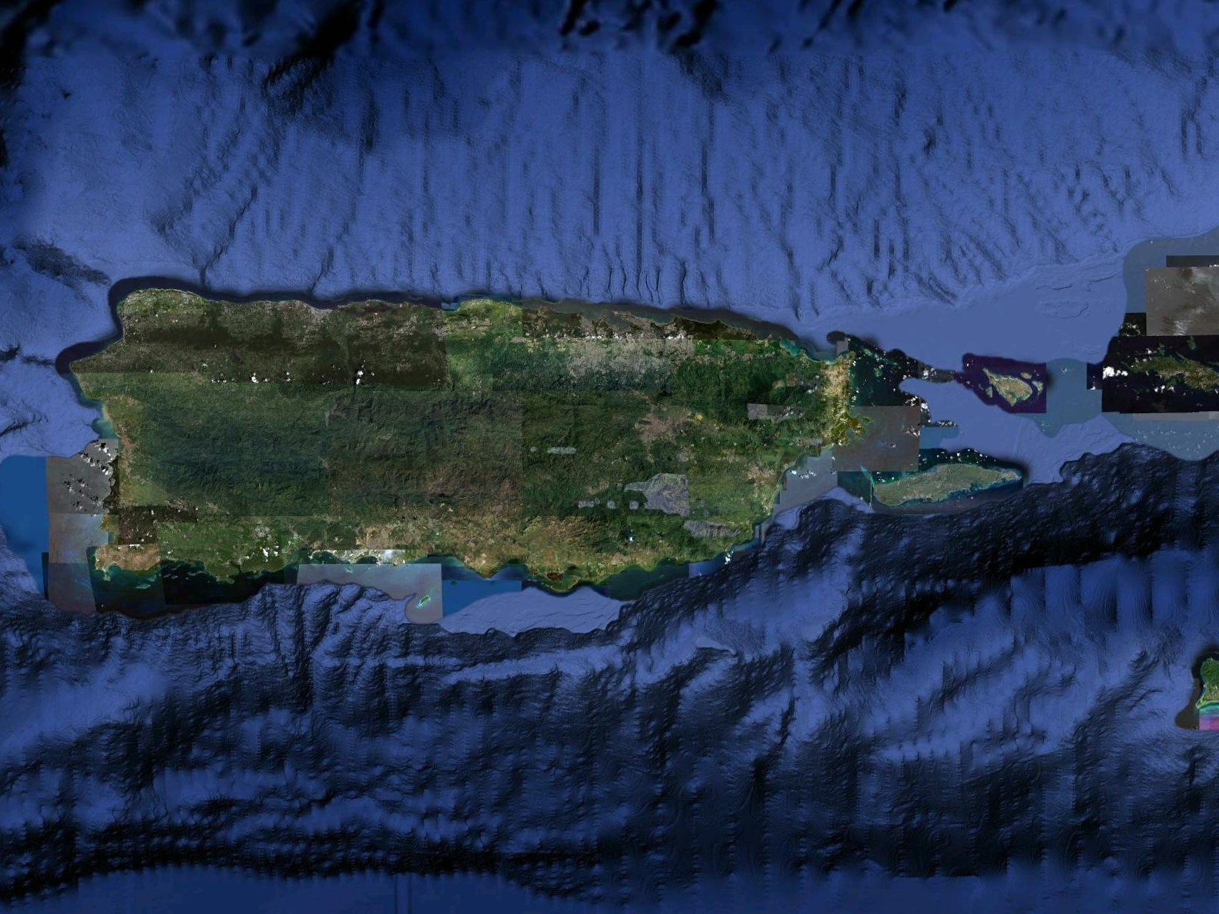
LOCATION
San Juan
Rio Grande
Luquillo
Airport
Culebra
Fajardo
+35 Miles,
60 minute drive
Ceiba
Roosevelt
Roads
Vieques
Ponce
Puerto Rico, USA
Roosevelt Roads Redevelopment
Notes:
2

Slide 3
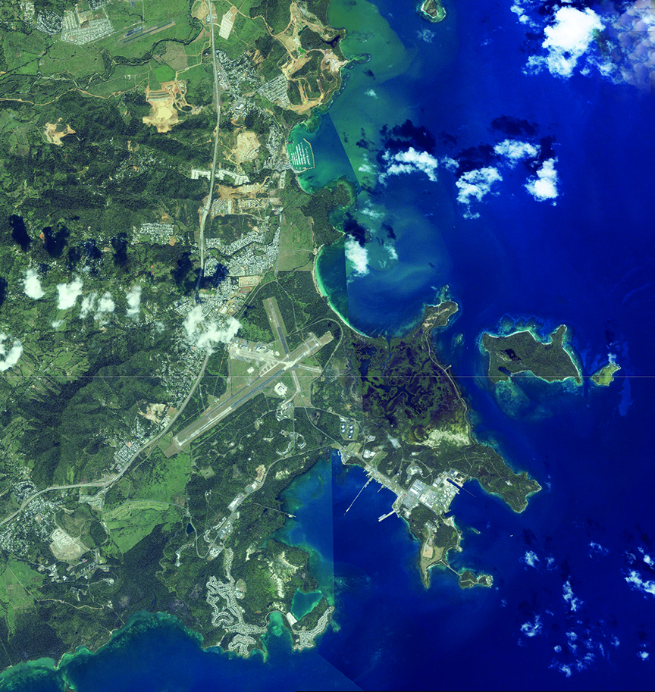
ROOSEVELT ROADS REDEVELOPMENT
Roosevelt Roads Redevelopment
Ceiba, Puerto Rico USA

Slide 4
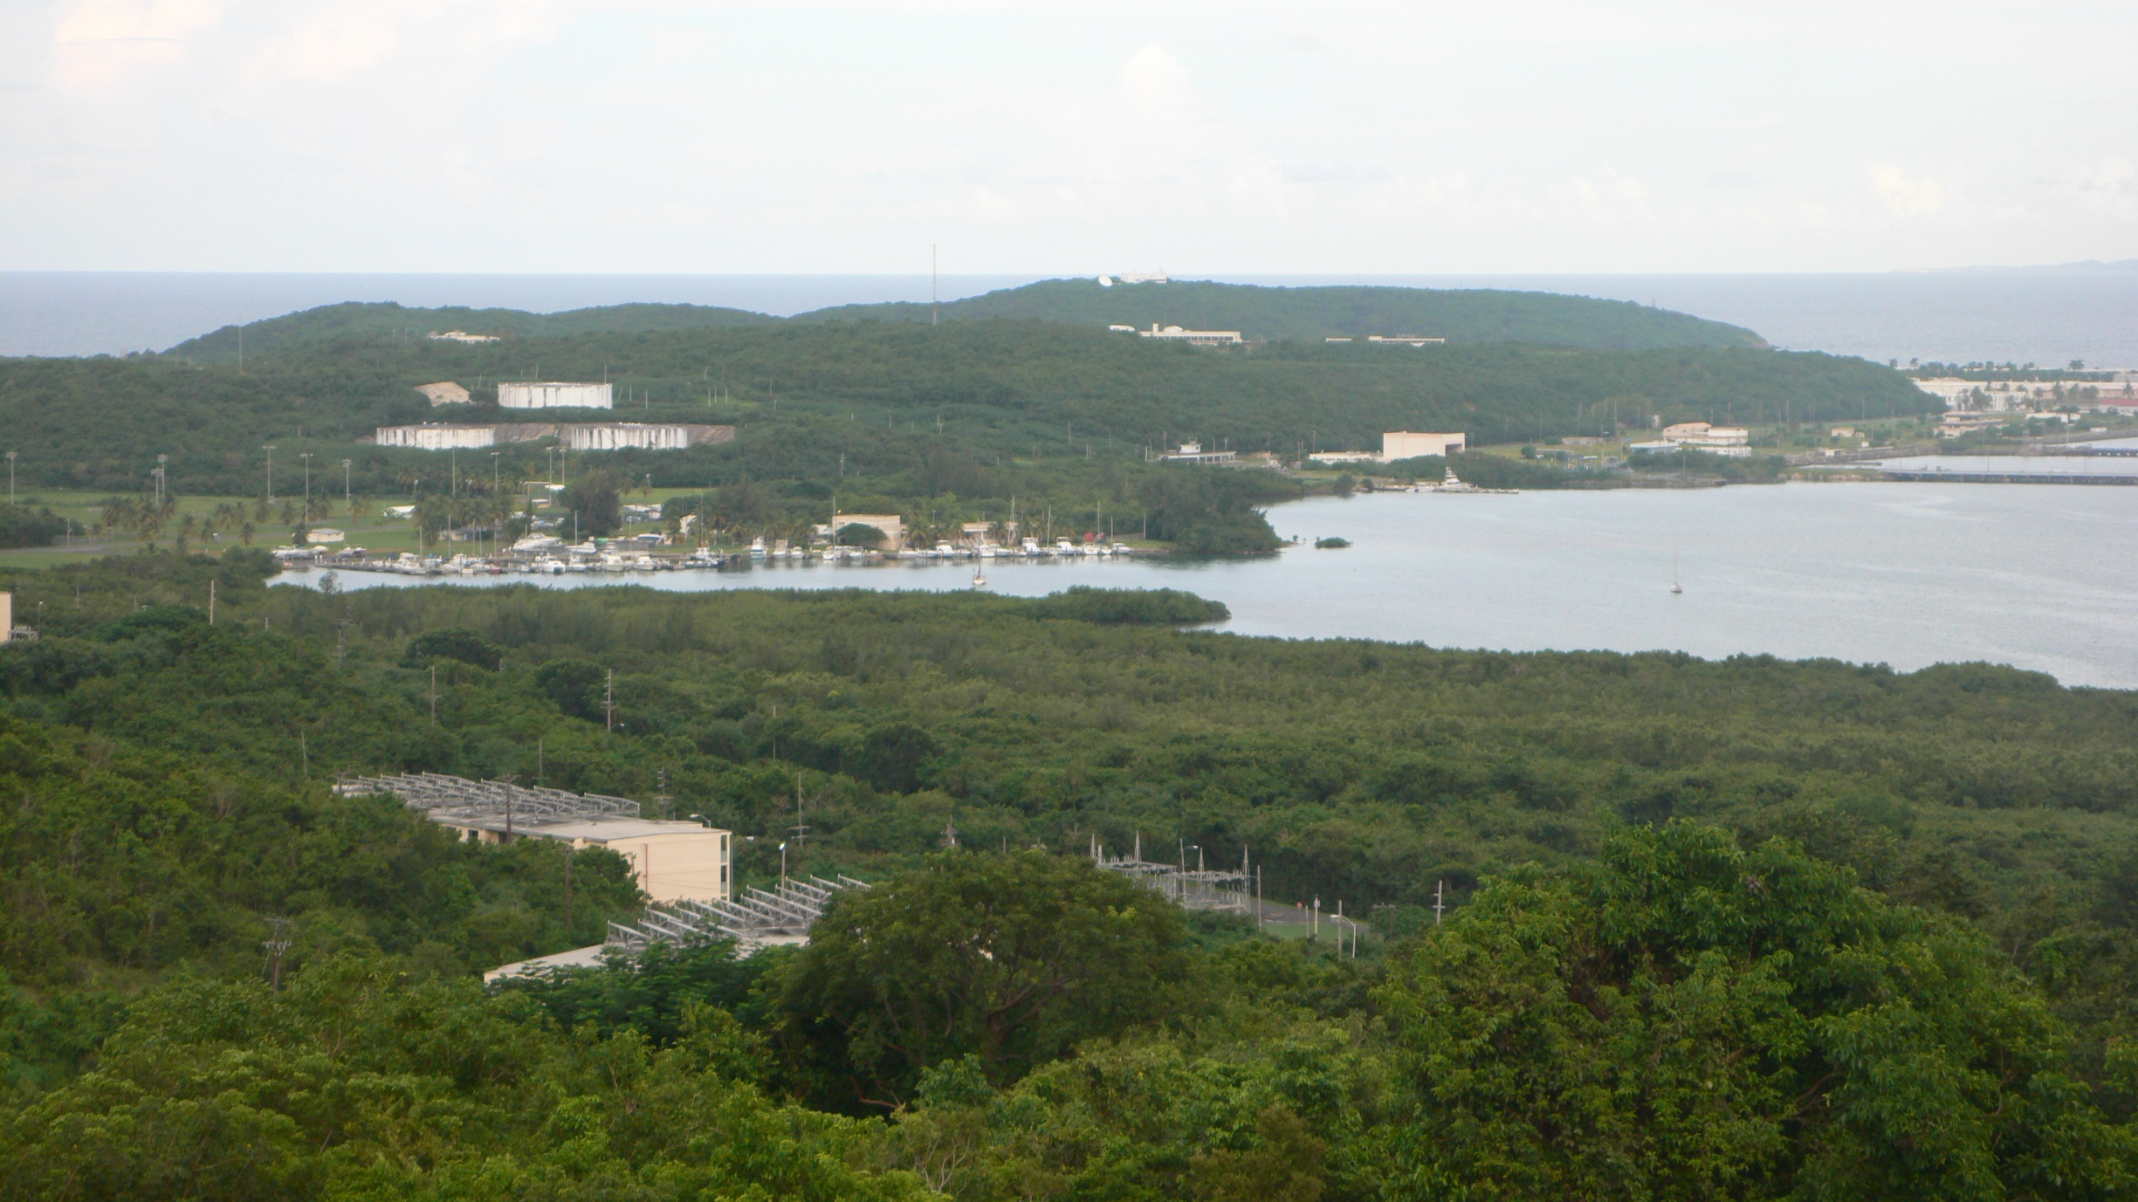
ROOSEVELT ROADS REDEVELOPMENT
Closure of U. S. Naval Station Roosevelt Roads (NSRR) in Ceiba, Puerto Rico occurred in March, 2004 pursuant to the 2004 U.S. Department of Defense Appropriations Act
In 2004, Puerto Rico Law 508 created the Local Redevelopment Authority (LRA) for Naval Station Roosevelt Roads in charge of implementing the NSRR Redevelopment Project
The Roosevelt Roads Redevelopment project is one of Puerto Rico’s foremost economic development initiatives, comprised of 8,720 acres of high economic, ecological, historical and cultural value.

Slide 5
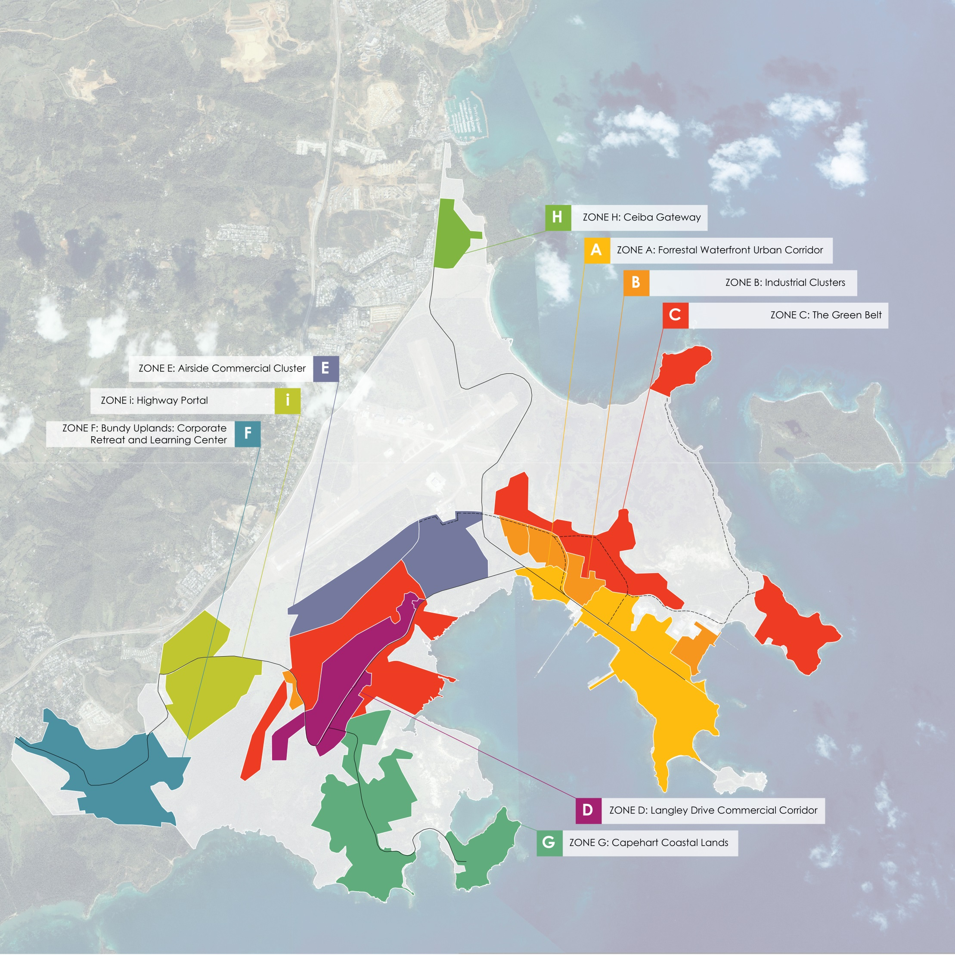
2014 SPECIAL PLAN

Slide 6
Grant Management - General
LRA has been receiving federal funds since October 1, 2003 on a 90/10 basis from the Office of Economic Adjustment (OEA) of the Department of Defense.
For grants to be received in FY 2016 and 2017, it will be on a 75/25 basis.
FY 2017 is the last year for receiving federal funds from OEA.
The LRA has received approximately $7.4 million in federal funds from OEA as of today.
Grant for FY 2014-2015 is for approximately $1.5 million.

Slide 7
Grant Management – Administrative
OEA grant is requested and approved on a yearly basis.
Covers salaries and fringe benefits, and operational expenses such as rent, office supplies, advertising, insurance and utilities.
Has also covered contractual expenses such as legal, architectural & engineering, and master plan and infrastructure planning consulting services.
Does not cover maintenance nor infrastructure expenses for the property.
Requires submission of quarterly and yearly reports comparing achievements with objectives and goals.

Slide 8
Grant Management – Best Practices
Great communication with Project Manager for the grant. If something goes wrong with the administration of the grant, be transparent and communicate it immediately.
Complies with 32 CFR Part 33, “Uniform Administrative Requirements for Grants and Cooperative Agreements to State and Local Governments”.
Complies with OMB Circular A-133 and perform a Single Audit each year.
Stay away of non-compliance.

Slide 9
Local Redevelopment Authority for Roosevelt Roads
Questions?
FOR MORE INFORMATION CONTACT:
Local Redevelopment Authority of Roosevelt Road
787-758-4747 ext. 5116
www.rooseveltroads.pr.gov

